Slide 1
1
Problem Definition and Scope
VisionAssist | DevSecOps Lab CIAP | Deep Kalpesh Modh, Roll No. 27 | SDG 9
The problem
Scope
Printed text (labels, forms, notices) is hard for visually impaired users to read alone
Needs: photo to speech, high contrast, no special software
The app must also be built, tested and deployed securely and repeatably
In: browser OCR + speech, Docker, Jenkins, Terraform on AWS, SonarQube and Trivy scans
Out: user accounts, HTTPS, multi-language OCR, testing with real users

Slide 2
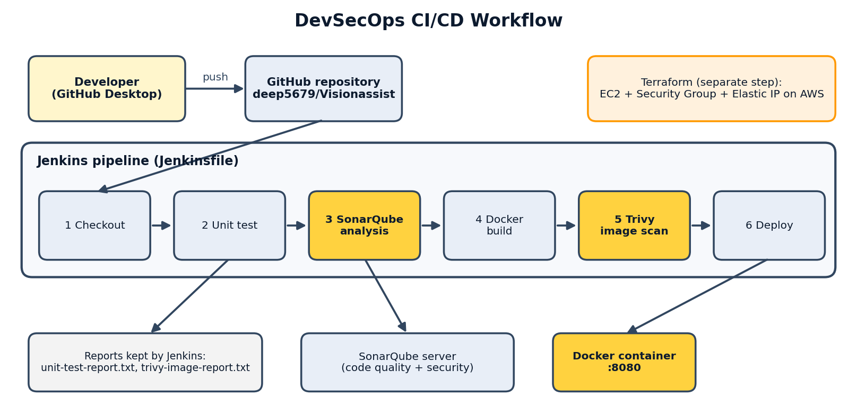
2
System Design and DevSecOps Workflow
Static site, OCR and speech run in the browser
nginx (non-root) in Docker on AWS EC2
Security checks at every stage
Security by design: non-root container, patched base image, inbound TCP 80 only, egress 80/443, encrypted disk, IMDSv2, SRI hash on the CDN script

Slide 3
3
Website Implementation and Testing
What it does
How it was tested
Choose or take a photo of text
Tesseract.js reads the text in the browser
Web Speech API reads it aloud, adjustable speed
Dark/light high contrast, A-/A+ text size, skip link, focus outlines
Run locally, in Docker and on AWS
OCR on a form screenshot: text recognised, small errors on tiny text
Unit test for utils.js in the Jenkins pipeline
Photos stay on the device (privacy)

Slide 4
4
Docker Deployment and Jenkins Pipeline
Docker
Jenkins
Base: nginx-unprivileged on Alpine, port 8080
apk upgrade, then back to non-root user
Images 1.0 > 1.1 (patched) > 1.2 (final)
docker build, then docker run on :8080
Checkout, unit test, SonarQube, Docker build, Trivy scan
Reports archived as build artifacts
2m 22s
Build #3 passed (Jenkins 2.541.3)

Slide 5
5
AWS Infrastructure Using Terraform
Terraform creates
Challenge
EC2 t3.micro (Amazon Linux 2023), encrypted disk, IMDSv2
Security group: in TCP 80; out TCP 443/80
Elastic IP for a fixed address
Startup script: install Docker, clone GitHub, build, run
Mumbai was blocked by an AWS Organization policy (SCP). Other regions were tested and the site was deployed in Sydney (ap-southeast-2). Apply: 2 added, then re-applied with an Elastic IP.

Slide 6
6
Security Scan Results and Vulnerability Report
57 > 0
E > A
1 > 2
Trivy image: High + Critical, after apk upgrade
SonarQube Security; 3 issues > 0 open
Trivy Terraform AWS-0104: mitigated, accepted
Fixed: regex backtracking (utils.js), missing SRI hash (index.html), outdated OS packages
Accepted risk: site must be public (port 80); egress destination 0.0.0.0/0; Dockerfile build-time root
Not scanned: Tesseract CDN library; test coverage is 0.0%

Slide 7
7
Analysis and Reflection
What the results show
What I learned
All 57 image findings came from the base image, not our code
Present does not mean exploitable, but patching is still right
A clean scan is not a safe system: public exposure remains
Scan, fix, re-scan gives measurable proof
Never show keys or tokens in screenshots
Read errors carefully and check the folder first

Slide 8
8
Conclusion and Future Scope
Conclusion
Future scope
VisionAssist delivered through Git, Docker, Jenkins, Terraform, SonarQube and Trivy
Real issues found, fixed and measured
Supports SDG 9: innovation with secure, repeatable infrastructure
HTTPS, domain, WAF
Self-host Tesseract.js
Tests with coverage in SonarQube
Private subnet with egress allow-list
Test with visually impaired users

